Slide 1
Relational Database Design Algorithms

Slide 2
DESIGNING A SET OF RELATIONS
Bottom-up Design Approach:
Find all FD’s from the mini-world.
Constructs a minimal set of FDs
Construct a Universal Relation Schema R
Decompose R into a target set of 3NF or BCNF relations.
Additional Criteria
Attribute preservation
Dependency Preservation
Lossless (Non-additive) Join

Slide 3
Properties of Relational Decompositions
Universal Relation Schema: a relation schema R={A₁, A_{2,} …, A_{n}} that includes all the attributes of the database.
Decomposition: Decompose R into a set of relation schemas D = {R₁,R₂, …, R_{m}} by using the FD’s into 3NF or BCNF.
Notes:
Universal relation assumption: every attribute name is unique.

Slide 4
Properties of Relational Decompositions
Attribute preservation condition:
Each attribute in R will appear in at least one relation schema R_{i} in the decomposition so that no attributes are “lost”.
Dependency Preservation Property
It is always possible to find a dependency-preserving decomposition D with respect to F such that each relation R_{i} in D is in 3NF.
Lossless (Non-additive) Join Property
* (π_{R1}(r), ..., π_{Rm}(r)) = r
lossless refers to loss of information, not to loss of tuples. In fact, for “loss of information” a better term is “addition of spurious information”
Notes:
Note: The word loss in lossless refers to loss of information, not to loss of tuples. In fact, for “loss of information” a better term is “addition of spurious information”
It is not necessary that the exact dependencies specified in F appear themselves in
individual relations of the decomposition D. It is sufficient that the union of the
dependencies that hold on the individual relations in D be equivalent to F. We now
define these concepts more formally.
Definition. Given a set of dependencies F on R, the projection of F on Ri,
denoted by πRi(F) where Ri is a subset of R, is the set of dependencies X→Y in
F+ such that the attributes in X ∪ Y are all contained in Ri. Hence, the projection
of F on each relation schema Ri in the decomposition D is the set of functional
dependencies in F+, the closure of F, such that all their left- and
right-hand-side attributes are in Ri. We say that a decomposition D = {R1,
R2, ..., Rm} of R is dependency-preserving with respect to F if the union of the
projections of F on each Ri in D is equivalent to F; that is, ((πR1(F)) ∪ ... ∪
(πRm(F)))+ = F+.
If a decomposition is not dependency-preserving, some dependency is lost in the
decomposition. To check that a lost dependency holds, we must take the JOIN of
two or more relations in the decomposition to get a relation that includes all leftand
right-hand-side attributes of the lost dependency, and then check that the
dependency holds on the result of the JOIN—an option that is not practical.
An example of a decomposition that does not preserve dependencies is shown in
Figure 15.13(a), in which the functional dependency FD2 is lost when LOTS1A is
decomposed into {LOTS1AX, LOTS1AY}. The

Slide 5
Algorithm : for Testing Lossless Join Property
Input: A universal relation R,
a decomposition D = {R₁, R₂, ..., R_{m}} of R, and
a set F of functional dependencies.

Slide 6
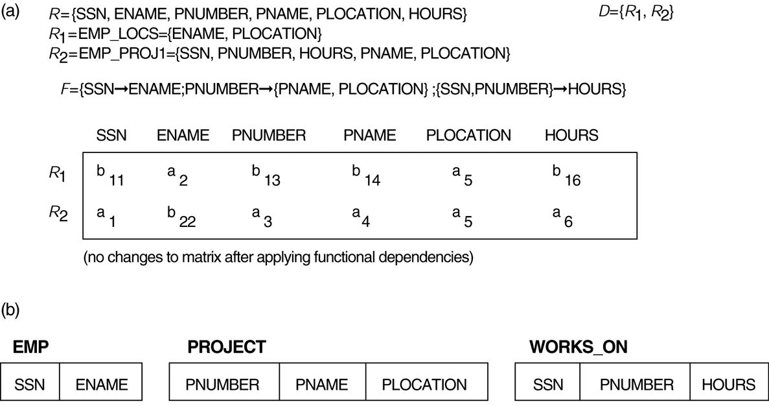
Properties of Relational Decompositions (8) Lossless (nonadditive) join test for n-ary decompositions.

Slide 7
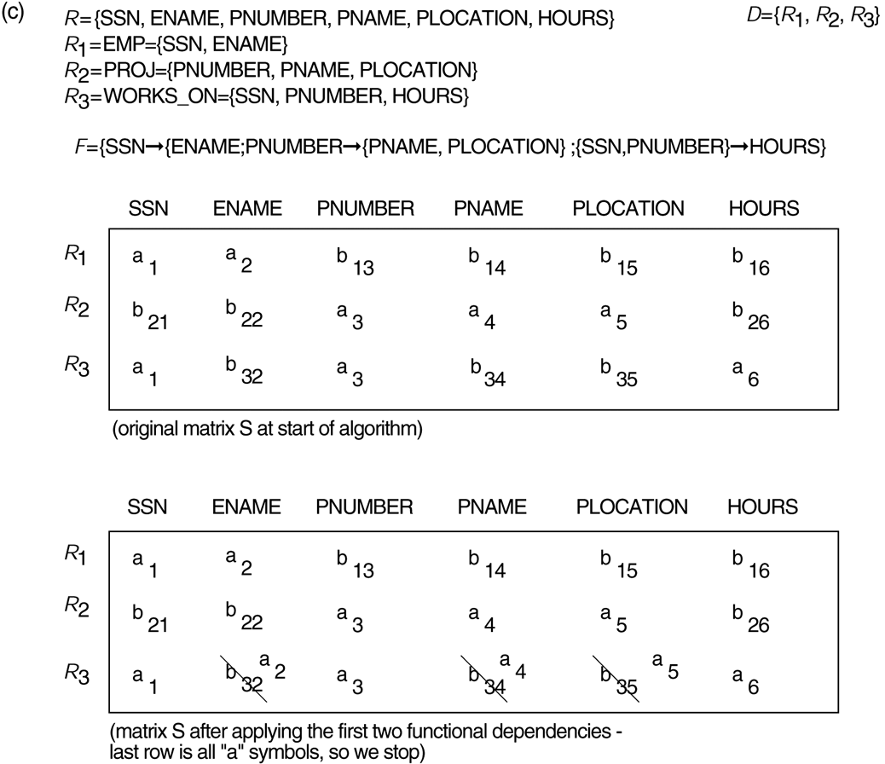
Properties of Relational Decompositions (8)

Slide 8
Properties of Relational Decompositions (8)

Slide 9
Properties of Relational Decompositions (8)

Slide 10
Properties of Relational Decompositions (8) Lossless (nonadditive) join test for n-ary decompositions. (a) Case 1: Decomposition of EMP_PROJ into EMP_PROJ1 and EMP_LOCS

Slide 11
Properties of Relational Decompositions (8) Lossless (nonadditive) join test for n-ary decompositions. (a) Case 1: Decomposition of EMP_PROJ into EMP_PROJ1 and EMP_LOCS

Slide 12
Testing Binary Decompositions for Lossless Join Property:
Binary Decomposition: decomposition of a relation R into two relations.
Lossless join test for binary decompositions: A decomposition D = {R₁, R₂} of R has the lossless join property with respect to a set of functional dependencies F on R if and only if either
The FD ((R₁ ∩ R₂)  (R₁- R₂)) is in F⁺, or
The FD ((R₁ ∩ R₂)  (R₂ - R₁)) is in F⁺.

Slide 13
Algorithm: Decomposition into 3NF with Dependency Preservation &Lossless Join
Input: A universal relation R and a set of functional dependencies F on the attributes of R.
Find a minimal cover G for F
For each X of a FD in G, create a relation in D with attributes {X υ {A₁} υ {A₂} ... υ {A_{k}}},
where X  A₁, X  A₂, ..., X –>A_{k} are the only FD’s in G with X as LHS (X is the key of this relation).
If none of the relation in D contains a key of R, then create one more relation in D that contains key of R.
Eliminate Redundant relations from D

Slide 14
Example
Consider U(ssn,pno,sal,phone,dno,pname,ploc)
Consider following FDs
FD1: ssn ->sal,phone,dno
FD2: pno-> pname,ploc
FD3: {ssn,pno }->sal,ephone,dno,pname,ploc
Key: {ssn,pno}
Step1: minimal cover
G: {ssn->sal,phone,dno; pno->pname,ploc}
Step2:
R1(ssn,sal,phone,dno)
R2(pno,pname,ploc)
Step3:
R3(ssn,pno)

Slide 15
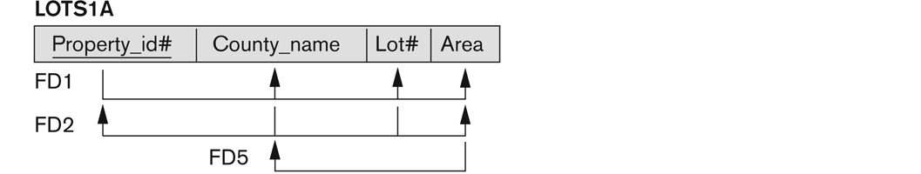
Example: property LoT
Consider LOTS1A is a Universal Relation with FD’s
F: {P->LCA, LC->AP, A->C}
Step1: Minimal cover
GX:{P->LC, LC->AP,A->C}
Step2:
Design X: R1(P,L,C), R2(L,C,A,P), R3(A,C)
Step4: Remove redundant relations
Design X: R2(L,C,A,P)
Notes:
MC 2 == P-> LA, LC->P and A->C

Slide 16
Algorithm : For Relational Decomposition into BCNF with Lossless join property
Input: A universal relation R and a set of functional dependencies F on the attributes of R.
Set D := {R};
While there is a relation schema Q in D that is not in BCNF
do {
choose a Q in D that is not in BCNF;
find a FD X  Y in Q that violates BCNF;
replace Q in D by two relations (Q - Y) and (X υ Y);
};
Assumption: No null values are allowed for the join attributes.

Slide 17
Example: Teach Relation
Two FDs exist in the relation TEACH:
FD1: { student, course} -> instructor
FD2: instructor -> course
{student, course, instructor} not in BCNF
FD2 violates BCNF
Replace relation Q by two relations (Q - Y) and (X υ Y);
R1(student, instructor}
R2(instructor, course}

Slide 18
How to find Relation is in BCNF?
For each FD X-> Y in Q, find whether X+ fails to include all attributes in Q,
This helps to determine X is superkey or not

Slide 19
BCNF Example
Example: University faculty.
Two professors can have the same name, but only if they are in different departments (names must be unique within departments).
A professor has one office. Each department has its own building in which it has multiple offices. Professors can share offices.
name | department | office | title | salary
Alice | Math | Math 101 | Professor | 90,000
Bob | Physics | Physics 202 | Asst. Professor | 80,000
Charlie | Math | Math 101 | Assoc. Professor | 80,000
Denise | Physics | Physics 204 | Professor | 92,000
Jane | Physics | Physics 203 | Asst. Professor | 85,000
Mark | CS | CS 190 | Asst. Professor | 86,000
Mark | History | Hist 100 | Assoc. Professor | 70,000
Ned | CS | CS 195 | Professor | 90,000
Sarah | CS | CS 177 | Asst. Professor | 98,000
Vanessa | History | Hist 100 | Asst. Professor | 40,000
Notes:
The best way to understand BCNF intuitively is that each attribute of a record can be determined only by a key, and not by any non-key attribute or set of attributes. In other words, the left-hand side of every functional dependency is a candidate key. (When I say "determined", I mean by a FD in a provided set F or by a FD in the closure of F. Always be careful that the determination is based on FDs that have been provided, and not based on the data or on intuition.)3NF allows some attributes to be determined by some non-key values, but only if those non-key values are part of a candidate key. This can introduce redundancy.

Slide 20
BCNF
Faculty(name, department, office, title, salary)
Primary Key is (name, department)
Candidate key is (name, office)
FDs implied by requirements are:
name, department → name, department, office, title, salary
office → department
name, office → name, department, office, title, salary
BCNF Relations
R1(name, office, title, salary)
R2(office, dept).
Notes:
This is in 3NF, but it is not in BCNF, because office alone is not a candidate key (the second FD vioaltes BCNF). There is non-essential redundancy between department and office: if we know the office, we automatically know the department.
We can put it in BCNF by replacing it with two new tables based on the FD office → department. One table contains (name, office, title, salary), with (name, office) as primary key. The second table contains (office, dept), with office as primary key.

Slide 21
Exercise Problem
Consider the universal relation R = {A, B, C, D, E, F, G, H, I, J} and the set of functional dependencies
F = { {A, B}→{C}, {A}→{D, E}, {B}→{F}, {F}→{G,H}, {D}→{I, J} }.
What is the key for R?
Decompose R into 3NF relations
Apply the synthesis algorithm to decompose R into 3NF relations
Decompose R into BCNF relations.
Notes:
Key AB

Slide 22
Solution
AB is a key.
This can be determined by calculating AB+ with respect to the set F.
2NF
R1 (A, B, C)
R2 (A,D,E,I,J)
R3 (B, F, G, H)
3NF
R1 (A, B, C)
R2.1 (A,D,E)
R2.2 (D, I, J)
R3.1 (B, F)
R3.2 (F, G, H)
Notes:
To normalize R intuitively into 2NF then 3NF, we take the following steps (alternatively, we can apply the algorithms discussed in Chapter 15):
First, identify partial dependencies that violate 2NF. These are attributes that are functionally dependent on either parts of the key, {A} or {B}, alone.
We can calculate the closures {A}+ and {B}+ to determine partially dependent attributes: {A}+ = {A, D, E, I, J}. Hence {A} -> {D, E, I, J} ({A} -> {A} is a trivial dependency) {B}+ = {B, F, G, H}, hence {A} -> {F, G, H} ({B} -> {B} is a trivial dependency)
To normalize into 2NF, we remove the attributes that are functionally dependent on part of the key (A or B) from R and place them in separate relations R1 and R2, along with the part of the key they depend on (A or B), which are copied into each of these relations but also remains in the original relation, which we call R3 below: R1 = {A, D, E, I, J}, R2 = {B, F, G, H}, R3 = {A, B, C} The new keys for R1, R2, R3 are underlined. Next, we look for transitive dependencies in R1, R2, R3. The relation R1 has the transitive dependency {A} -> {D} -> {I, J}, so we remove the transitively dependent attributes {I, J} from R1 into a relation R11 and copy the attribute D they are dependent on into R11. The remaining attributes are kept in a relation R12. Hence, R1 is decomposed into R11 and R12 as follows: R11 = {D, I, J}, R12 = {A, D, E}

Slide 23
Decompositions of previous question
Determine whether each decomposition has
(1) the dependency preservation property, and
(2) the lossless join property, with respect to F.
Also determine the normal form of each relation in the decomposition
R = {A, B, C, D, E, F, G, H, I, J}
F = { {A, B}→{C}, {A}→{D, E}, {B}→{F}, {F}→{G,H}, {D}→{I, J} }.
D1 = {R1, R2, R3, R4, R5} ;
R1 = {A, B, C} , R2 = {A, D, E} , R3 = {B, F} , R4 = {F, G, H} , R5 = {D, I, J}
D2 = {R1, R2, R3} ;
R1 = {A, B, C, D, E} , R2 = {B, F, G, H} , R3 = {D, I, J}
D3 = {R1, R2, R3, R4, R5} ;
R1 = {A, B, C, D} , R2 = {D, E} , R3 = {B, F} , R4 = {F, G, H} , R5 = {D, I, J}
Notes:
D1 is lossless and BCNF, dependencies preserved
D2 is lossless and 1NF , dependencies preserved
D3 is lossy and 1NF, dependencies not preserved

Slide 24
Discussion of Normalization Algorithms: Problems:
We have to specify all the relevant functional dependencies among the database attributes.
These algorithms are not deterministic in general.
It is not always possible to find a decomposition into BCNF relation schemas that preserves dependencies.
Notes:
For example, the synthesis algorithms (Algorithms 16.4 and 16.6) require
the specification of a minimal cover G for the set of functional dependencies F.
Because there may be in general many minimal covers corresponding to F, as we
illustrated in Example 2 of Algorithm 16.6 above, the algorithm can give different
designs depending on the particular minimal cover used. Some of these designs may
not be desirable. The decomposition algorithm to achieve BCNF (Algorithm 16.5)
depends on the order in which the functional dependencies are supplied to the algorithm
to check for BCNF violation. Again, it is possible that many different designs
may arise corresponding to the same set of functional dependencies, depending on
the order in which such dependencies are considered for violation of BCNF. Some
of the designs may be preferred, whereas others may be undesirable.

Slide 25
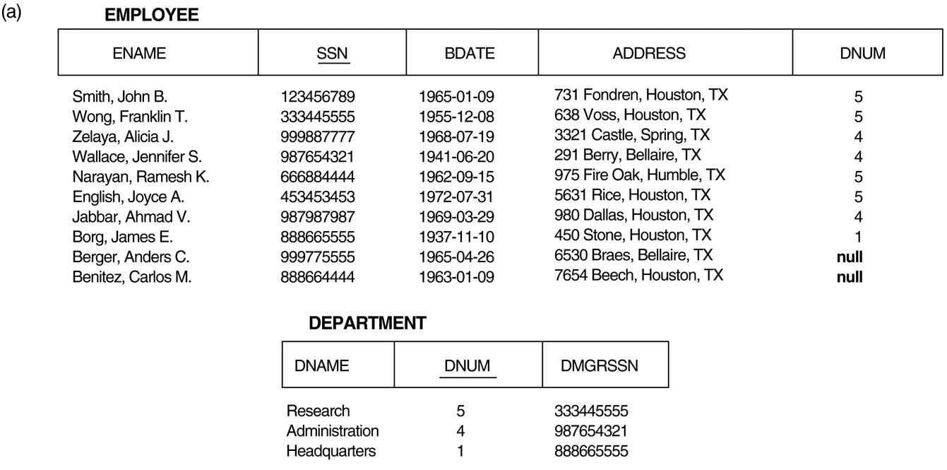
Issues with null-value joins
Notes:
In general, whenever a relational database schema is designed in which two or more
relations are interrelated via foreign keys, particular care must be devoted to watching
for potential NULL values in foreign keys. This can cause unexpected loss of
information in queries that involve joins on that foreign key. Moreover, if NULLs
occur in other attributes, such as Salary, their effect on built-in functions such as
SUM and AVERAGE must be carefully evaluated.

Slide 26
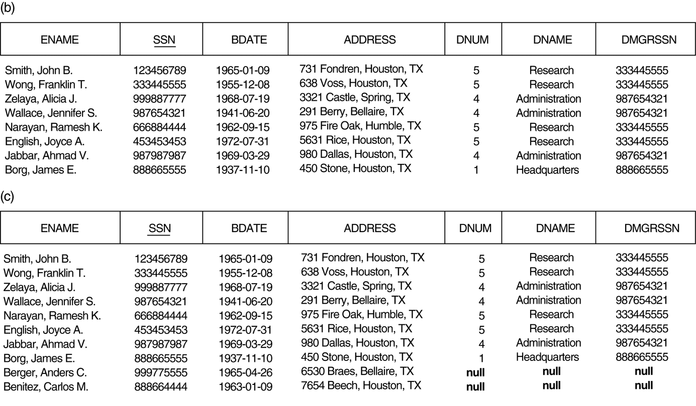
Result of applying NATURAL JOIN to the EMPLOYEE and DEPARTMENT relations
Issues with null-value joins

Slide 27
Result of applying LEFT OUTER JOIN to EMPLOYEE and DEPARTMENT.
Issues with null-value joins

Slide 28
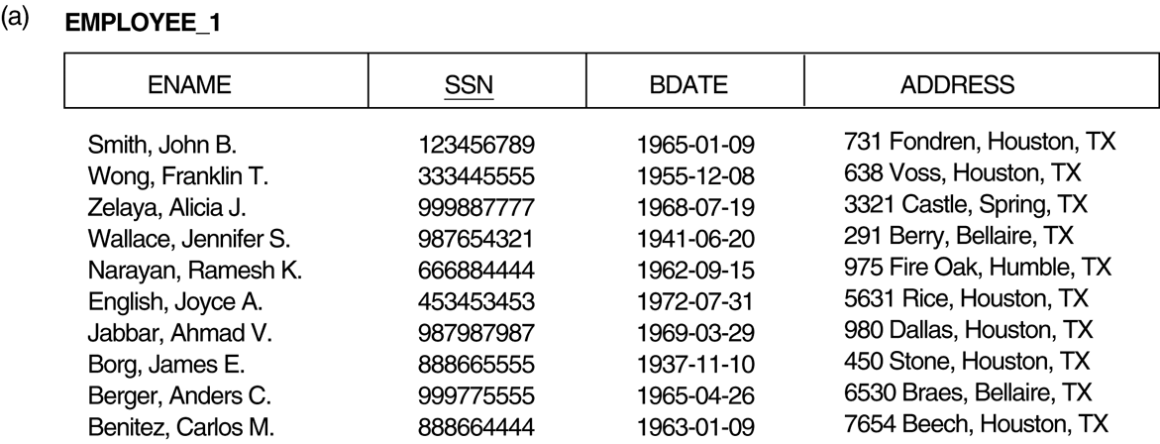
The “dangling tuple” problem The relation EMPLOYEE_1

Slide 29
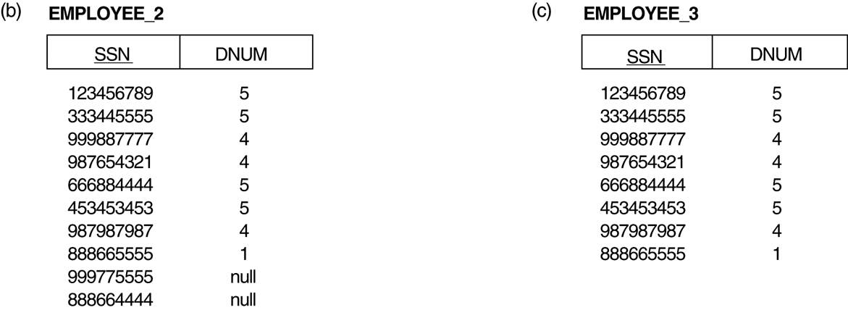
The “dangling tuple” problem (b) The relation EMPLOYEE_2 (includes DNUM attribute with null values). (c) The relation EMPLOYEE_3 (includes DNUM attribute but does not include tuples for which DNUM has null values).
Notes:
in EMPLOYEE_3 if the employee has not been assigned a department (instead of
including a tuple with NULL for Dnum as in EMPLOYEE_2). If we use EMPLOYEE_3
instead of EMPLOYEE_2 and apply a NATURAL JOIN on EMPLOYEE_1 and
EMPLOYEE_3, the tuples for Berger and Benitez will not appear in the result; these
are called dangling tuples in EMPLOYEE_1 because they are represented in only one
of the two relations that represent employees, and hence are lost if we apply an
(INNER) JOIN operation.

Slide 30
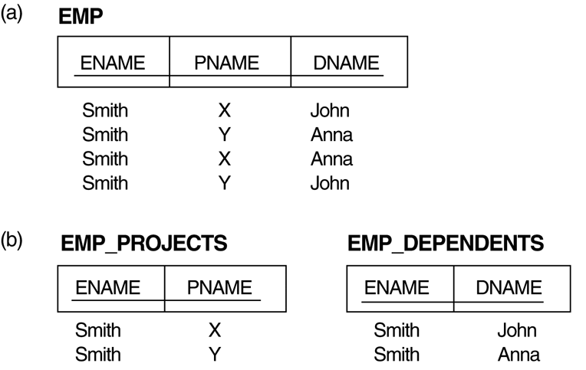
Multivalued Dependencies and Fourth Normal Form (a) The EMP relation with two MVDs: ENAME —>> PNAME and ENAME —>> DNAME. (b) Decomposing the EMP relation into two 4NF relations

Slide 31
Multivalued Dependencies (MVD)
MVD X —>> Y specifies the following constraint on any state r of R:
If two tuples t₁ and t₂ exist in r such that t₁[X] = t₂[X], then two tuples t₃ and t₄ should also exist in r with the following properties, where we use Z to denote (R - (X υ Y)):
· t₃[X] = t₄[X] = t₁[X] = t₂[X].
· t₃[Y] = t₁[Y] and t₄[Y] = t₂[Y].
· t₃[Z] = t₂[Z] and t₄[Z] = t₁[Z].
An MVD X —>> Y in R is called a trivial MVD if (a) Y is a subset of X, or (b) X υ Y = R.
Notes:
A multivalued dependency (MVD) on R, X ->>Y , says that if two tuples of R agree on all the attributes of X, then their components in Y may be swapped, and the result will be two tuples that are also in the relation.
i.e., for each value of X, the values of Y are independent of the values of R-X-Y.

Slide 32
Example: MVD
Customer(name, addr, phones, itemsLiked)
A customer’s phones are independent of the items they like.
name->>phones and name ->>itemsLiked.
Thus, each of a customer’s phones appears with each of the item they like in all combinations.
This repetition is unlike FD redundancy.
name->addr is the only FD.

Slide 33
Tuples Implied by name->>phones
If we have tuples:
name addr phones itemsLiked
sue a p1 b1
sue a p2 b2
sue a p2 b1
sue a p1 b2
Then these tuples must also be in the relation.

Slide 34
Fourth Normal Form
Relation R is in 4NF with respect to a set of dependencies F if, for every nontrivial multivalued dependency X —>> Y in F⁺, X is a superkey for R.
F⁺ includes functional dependencies and multivalued dependencies
An MVD X —>> Y in R is called a trivial MVD if
Y is a subset of X, or
X ∪ Y= R.
Example: EMP_PROJECTS has the trivial MVD Ename —>> Pname.
An MVD that satisfies neither (a) nor (b) is called a nontrivial MVD.
Notes:
Note: F⁺ is the (complete) set of all dependencies (functional or multivalued) that will hold in every relation state r of R that satisfies F. It is also called the closure of F.

Slide 35
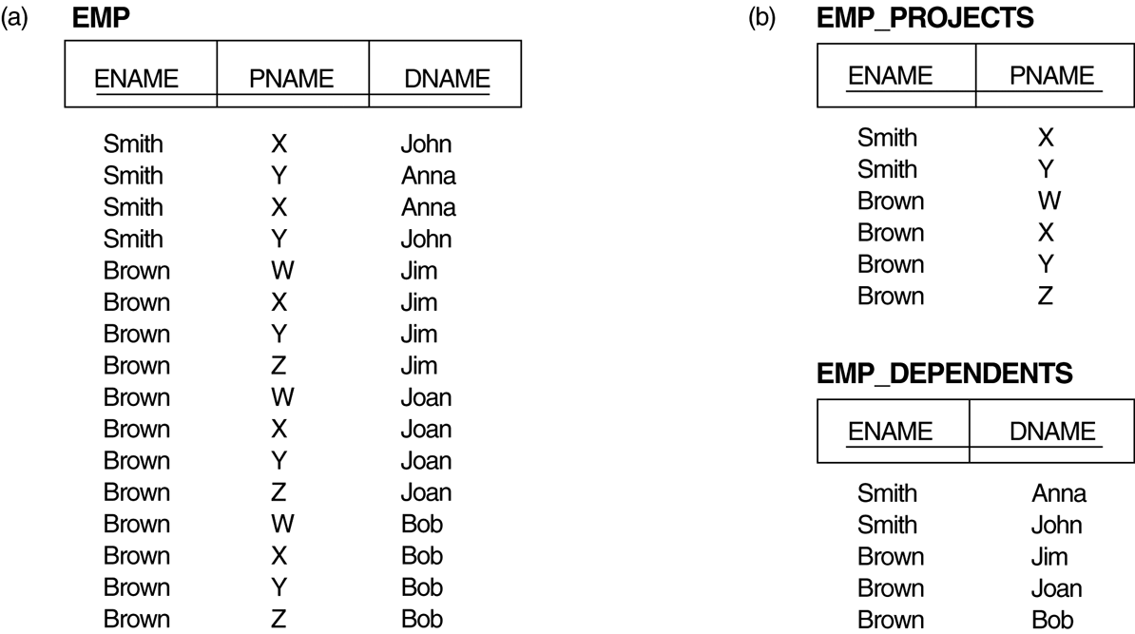
Fourth Normal Form Decomposing a relation state of EMP that is not in 4NF. (a) EMP relation with additional tuples. (b) Two corresponding 4NF relations EMP_PROJECTS and EMP_DEPENDENTS.

Slide 36
Lossless (Non-additive) Join Decomposition into 4NF Relations:
The relation schemas R₁ and R₂ form a lossless (non-additive) join decomposition of R with respect to a set F of functional and multivalued dependencies if and only if
(R₁ ∩ R₂) —>> (R₁ - R₂)
or by symmetry, if and only if
(R₁ ∩ R₂) —>> (R₂ - R₁)).

Slide 37
Fourth Normal Form
Algorithm: Relational decomposition into 4NF relations with non-additive join property
Input: A universal relation R and a set of functional and multivalued dependencies F.
Set D := { R };
While there is a relation schema Q in D that is not in 4NF do
{ choose a relation schema Q in D that is not in 4NF;
find a nontrivial MVD X —>> Y in Q that violates 4NF;
replace Q in D by two relation schemas (Q - Y) and (X υ Y);
};

Slide 38
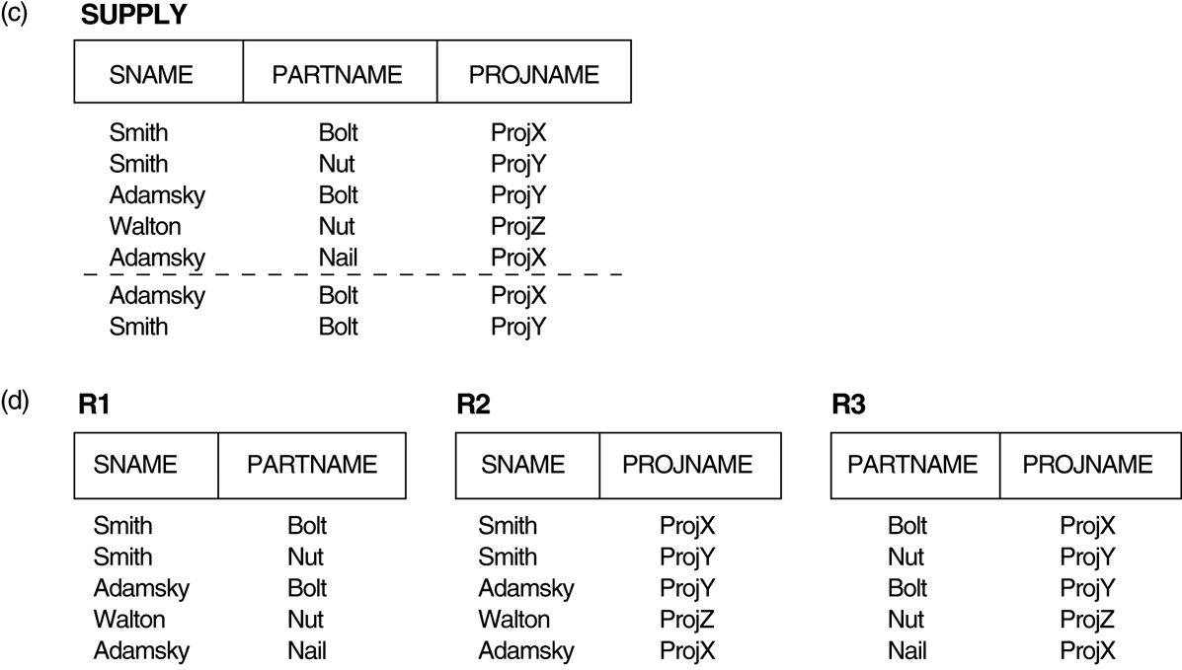
MVD and JD
Supplier s supplies part p, and
a project j uses part p, and
the supplier s supplies at least one part to project j, then supplier s will also be supplying part p to project j.
This constraint specifies a join dependency JD(R1, R2, R3) among the three projections
R1(Sname, Part_name),
R2(Sname, Proj_name),
R3(Part_name, Proj_name) of SUPPLY.

Slide 39
Join DependencY (JD)
Join Dependency, denoted by JD(R₁, R₂, ..., R_{n}), specified on R, specifies a constraint on the states r of R. The constraint states that every legal state r of R should have a non-additive join decomposition into R₁, R₂, ..., R_{n}; that is, for every such r we have
* (π_{R1}(r), π_{R2}(r), ..., π_{Rn}(r)) = r
Note: an MVD is a special case of a JD where n = 2.
A join dependency JD(R₁, R₂, ..., R_{n}), specified on relation schema R, is a trivial JD if one of the relation schemas R_{i} in JD(R₁, R₂, ..., R_{n}) is equal to R.

Slide 40
Fifth Normal Form
A relation schema R is in fifth normal form (5NF) (or Project-Join Normal Form (PJNF)) with respect to a set F of functional, multivalued, and join dependencies if, for every nontrivial join dependency JD(R₁, R₂, ..., R_{n}) in F⁺ (that is, implied by F), every R_{i} is a superkey of R.

